Slide 1
Module 4
Components

Slide 2
What are components
Components are the most basic building block of a UI in an Angular application. An Angular application is a tree of Angular components

Slide 3
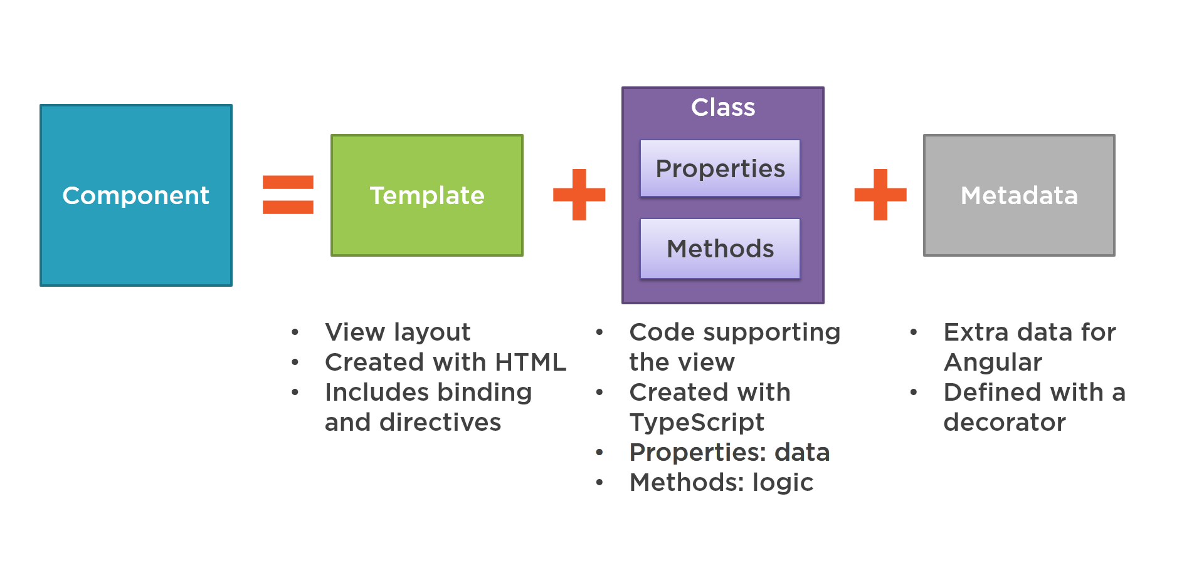
Component Composition

Slide 4
Understanding Component Lifecycle
Component instances have a lifecycle as Angular creates, updates, and destroys them. Developers can tap into key moments in that lifecycle by implementing one or more of the lifecycle hook interfaces in the Angular core library.

Slide 5
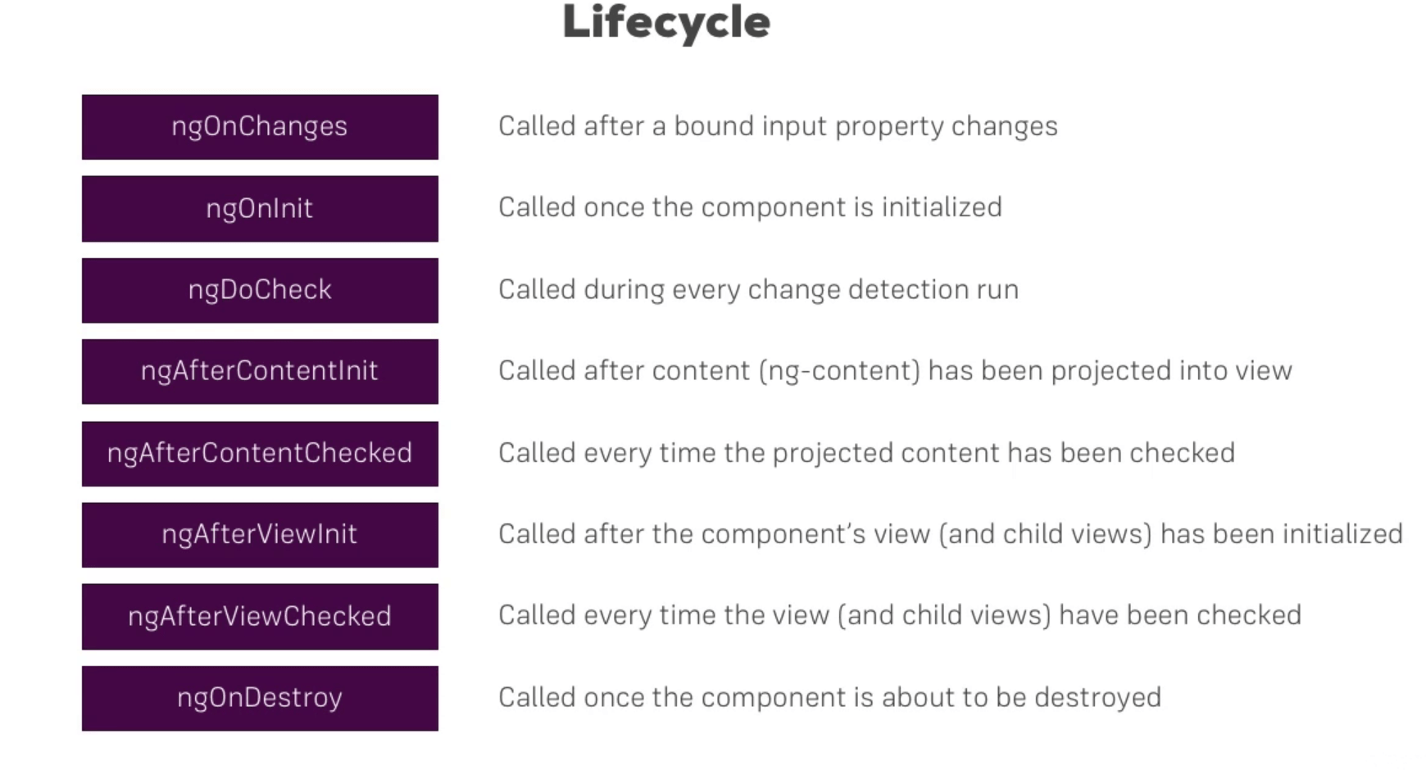
Component Lifecycle hooks

Slide 6
Creating Components and Using Components
ng generate component <component-name>
ng g c <component-name>

Slide 7
NgComponentOutlet
NgComponentOutlet provides a declarative approach for dynamic component creation.
@Component({selector: 'app-hello-world', template: 'hello world'})
export class HelloWorld{}
@Component({
selector: 'app-output-helloworld',
template: `<ng-container *ngComponentOutlet="HelloWorld"></ng-container>`
})
export class OutputHelloWorld{
HelloWorld = HelloWorld;
}

